Slide 1

SQL · DATA ANALYTICS · HR INTELLIGENCE
Employee Management
System
A relational database project analyzing workforce, payroll, and HR data using SQL
Project on SQL | Team Presentation

Slide 2
ABOUT ME
About Me
GS
G. Sanjana Priya
github.com/sanjanapriya21
BACKGROUND B.Tech in Electronics and Communication Engineering
WHY DATA SCIENCE I want to learn data science because turning raw data into actionable insights creates real business value.
EMPLOYEE MANAGEMENT SYSTEM
2

Slide 3
CONTEXT
Business Problem
Over the past year, payroll expenses rose significantly without a matching improvement in workforce efficiency. At the same time, HR noticed increasing leave requests and inconsistent compensation across departments.
MANAGEMENT RAISED SEVERAL CONCERNS
1
Which departments are driving the highest workforce costs?
2
Are employees with higher qualifications compensated fairly?
3
Are frequent leave patterns an early indicator of burnout?
4
Are salary and bonus allocations consistent across similar roles?
5
Which departments are cost-efficient, and which need attention?
6
Which employees should HR prioritize for retention or promotion?
EMPLOYEE MANAGEMENT SYSTEM
3

Slide 4
ROADMAP
Agenda
01
Introduction
02
Objective of the Project
03
ER Diagram
04
Key Analysis Questions
05
Conclusion
06
Experience / Challenges
EMPLOYEE MANAGEMENT SYSTEM
EMPLOYEE MANAGEMENT SYSTEM
4
4

Slide 5
OVERVIEW
Introduction
An Employee Management System is a relational database designed to manage employee information digitally. Instead of maintaining records manually, the system stores all organizational data in a centralised SQL database that manages:
ENTITY | INFORMATION STORED
Employee | Employee ID, Name, Gender, Contact
Department | Department Name
Job | Job Role, Salary Range
Salary | Salary Amount, Bonus
Qualification | Employee Education
Leaves | Leave Details
Payroll | Salary Payment Details
EMPLOYEE MANAGEMENT SYSTEM
5

Slide 6




GOALS
Objective of the Project
Generate insights
Centralised management
Analyze employee data using SQL to generate meaningful HR and business insights.
Manage employee, department, salary, payroll, qualification, and leave records through one database.
Data integrity
Support decisions
Minimize redundancy using database normalization, Primary Keys, and Foreign Keys.
Support HR decision-making by answering real-world queries and generating accurate SQL reports.
EMPLOYEE MANAGEMENT SYSTEM
6

Slide 7
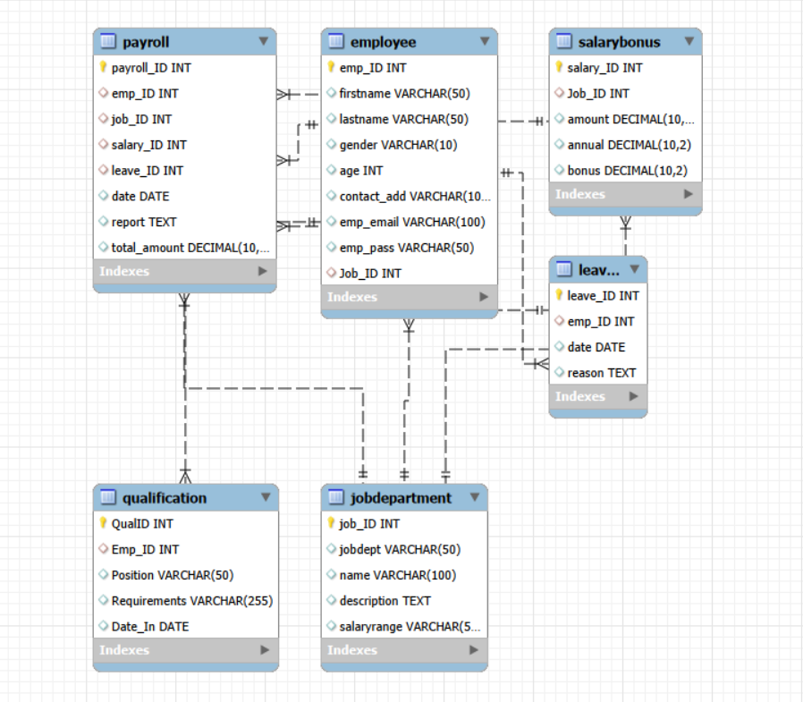
DATABASE DESIGN
Entity-Relationship Diagram
EMPLOYEE MANAGEMENT SYSTEM
7

Slide 8
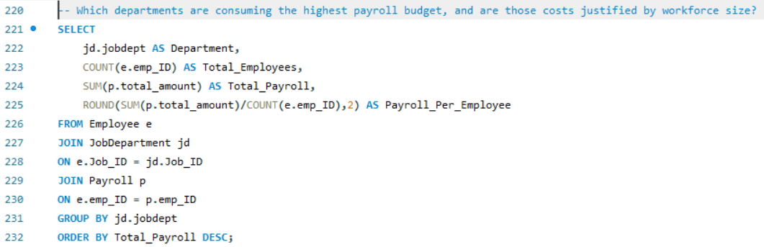
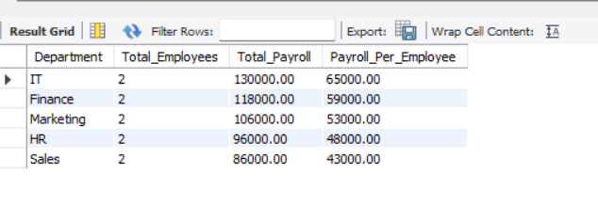
ANALYSIS 01
Which departments are consuming the highest payroll budget, and are those costs justified by workforce size?
EMPLOYEE MANAGEMENT SYSTEM
8

Slide 9
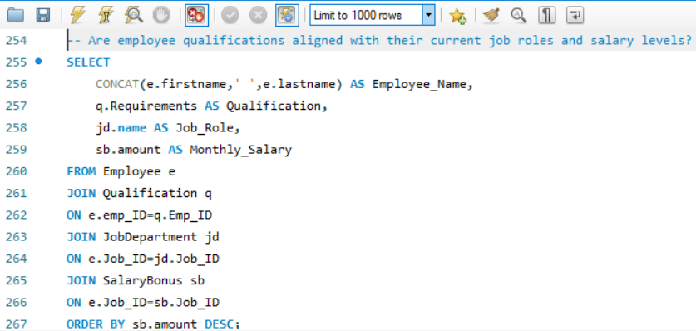
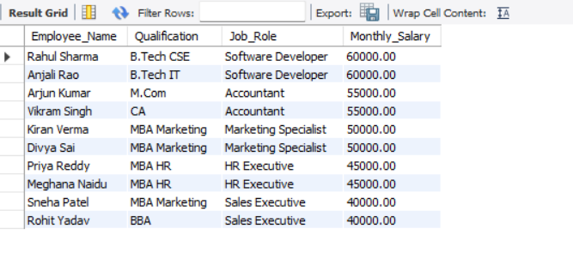
ANALYSIS 02
Are employee qualifications aligned with their current job roles and salary levels?
EMPLOYEE MANAGEMENT SYSTEM
9

Slide 10
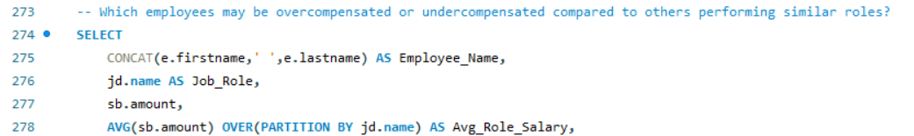
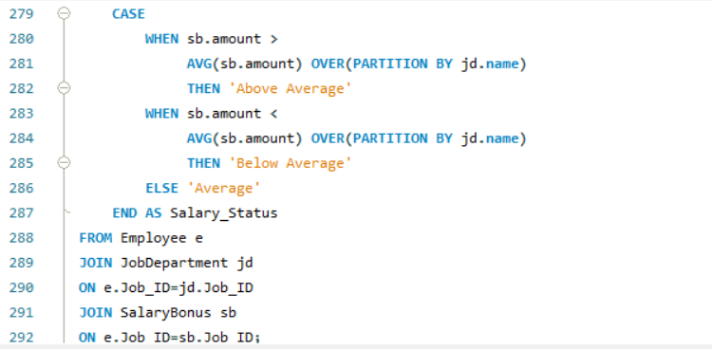
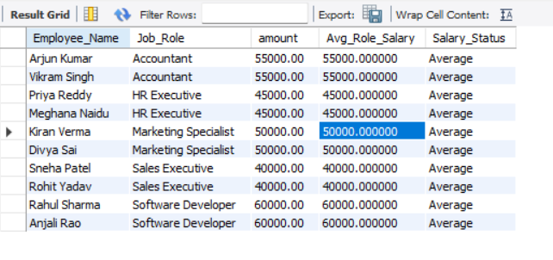
ANALYSIS 03
Which employees may be overcompensated or undercompensated compared to others performing similar roles?
EMPLOYEE MANAGEMENT SYSTEM
10

Slide 11
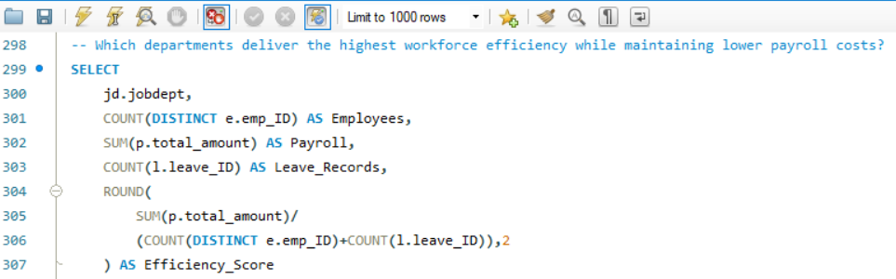
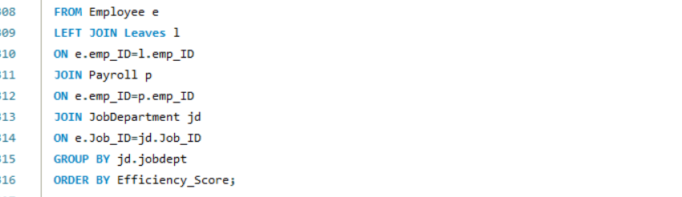
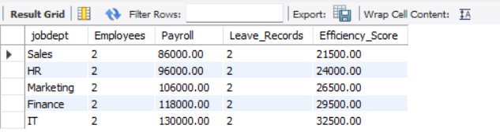
ANALYSIS 04
Which departments deliver the highest workforce efficiency while maintaining lower payroll costs?
EMPLOYEE MANAGEMENT SYSTEM
11

Slide 12
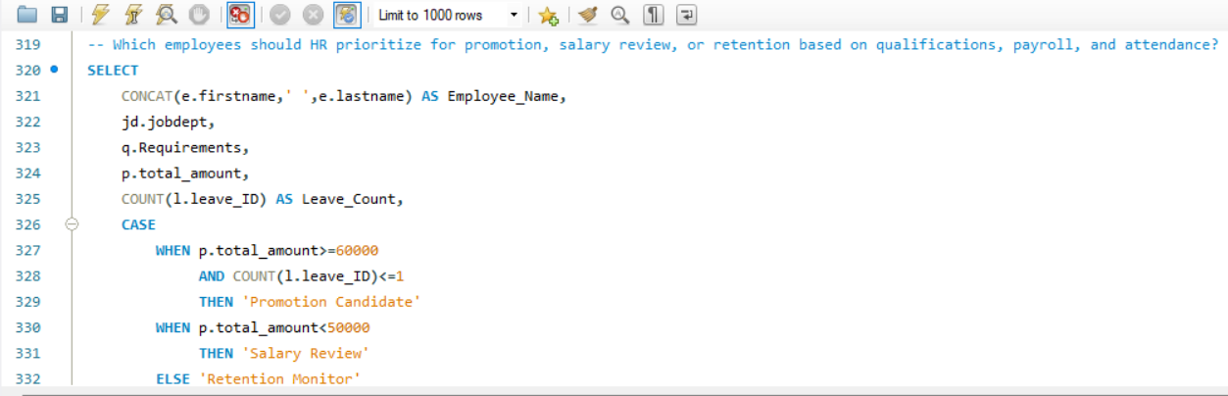
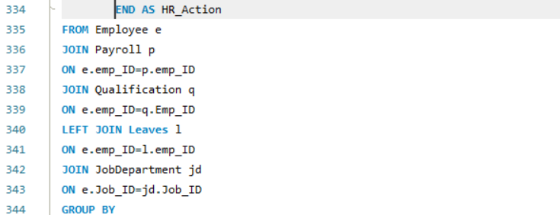
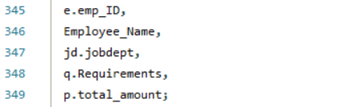
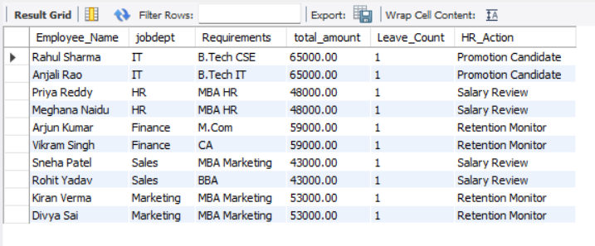
ANALYSIS 05
Which employees should HR prioritize for promotion, salary review, or retention based on qualifications, payroll, and attendance?
EMPLOYEE MANAGEMENT SYSTEM
12

Slide 13

WRAP UP
Conclusion
Developed an Employee Management System using SQL.
Solved real-world HR business problems by generating actionable insights for workforce planning and compensation analysis.
Applied JOINs, GROUP BY, aggregate functions, views, stored procedures, and triggers to support business decision-making.
Improved skills in database design, data analysis, and business problem-solving through a real-world case study.
Demonstrated how SQL can transform raw HR data into insights that help organizations optimize workforce and payroll management.
Strengthened practical knowledge of using SQL for data-driven business decisions rather than just data storage.
EMPLOYEE MANAGEMENT SYSTEM
13

Slide 14



REFLECTION
Experience & Challenges
Hands-on database design
Advanced SQL applied
Gained hands-on experience designing a relational database and building an SQL-based HR Intelligence System.
Applied JOINs, aggregate functions, views, stored procedures, and triggers to solve business problems.
Relationship challenges
Analytical growth
Faced challenges designing relationships between multiple tables and converting HR requirements into efficient queries.
Strengthened analytical thinking by transforming raw employee data into actionable insights for HR decision-making.
EMPLOYEE MANAGEMENT SYSTEM
14

Slide 15

Thank You
Employee Management System · SQL Project

